Slide 1
Theory of Automata
Regular Expressions
Dr. Aftab Maroof
Nasreen Akhtar
Faryal Saud

Slide 2
Contents
Regular Expressions
  Language Defining Symbols
  Alternation, Either/OR, Disjunction, Plus Sign
Defining Languages by Another New Method
Formal Definition of Regular Expressions
  Product Set
  Languages Associated with Regular Expressions
  Finite Languages Are Regular
  How Hard It Is to Understand a Regular Expression
Introducing EVEN-EVEN
Dr Aftab Maroof - Theory of Automata

Slide 3
Regular Expressions
RE is the sequence of characters or symbols that represent a finite or infinite set of text strings.
Pattern-matching is the process of checking whether a text string conforms to a set of characteristics defined by patterns such as regular expressions.
A regular expression is a set of pattern matching rules encoded in a string according to certain syntax rules. Although the syntax is somewhat complex it is very powerful and allows much more useful pattern matching than say simple wildcards like ? and *.
Dr Aftab Maroof - Theory of Automata

Slide 4
Regular Expression
A regular expression (sometimes abbreviated to "regex") is a way for a computer user or programmer to express how a computer program should look for a specified pattern in text and then what the program is to do when each pattern match is found.
For example, a regular expression could tell a program to search for all text lines that contain the word "Windows 95" and then to print out each line in which a match is found or substitute another text sequence (for example, just "Windows") where any match occurs.
The best known tool for specifying and handling the incidence of regular expressions is grep, a utility found in Unix-based operating systems and also offered as a separate utility program for Windows and other operating systems.
Dr Aftab Maroof - Theory of Automata

Slide 5
Language-Defining Symbols
We now introduce the use of the Kleene star, applied not to a set, but directly to the letter x and written as a superscript: x*.
This simple expression indicates some sequence of x’s (may be none at all):
x* =Λ or x or x² or x³…
= x^{n} for some n = 0, 1, 2, 3, …
Letter x is intentionally written in boldface type to distinguish it from an alphabet character.
We can think of the star as an unknown power. That is, x* stands for a string of x’s, but we do not specify how many, and it may be the null string .
Dr Aftab Maroof - Theory of Automata

Slide 6
R.E. Continued…
The notation x* can be used to define languages by writing, say L₄ = language (x*)
Since x* is any string of x’s, L₄ is then the language of all possible strings of x’s of any length (including Λ).
We should not confuse x* (which is a language-defining symbol or patron) with L₄ (which is the name we have given to a certain language).
Dr Aftab Maroof - Theory of Automata

Slide 7
R.E. Continued…
Given the alphabet = {a, b}, suppose we wish to define the language L that contains all words of the form: one a followed by some number of b’s (maybe no b’s at all), that is
L = {a, ab, abb, abbb, abbbb, …}
Using the language-defining symbol, we may write
L = language (ab*)
This equation obviously means that L is the language in which the words are the concatenation of an initial a with some or no b’s.
From now on, for convenience, we will simply say some b’s to mean some or no b’s. When we want to mean some positive number of b’s, we will explicitly say so.
Dr Aftab Maroof - Theory of Automata

Slide 8
R.E. Continued…
We can apply the Kleene star to the whole string ab if we want:
(ab)* = Λ or ab or abab or ababab…
Observe that
(ab)* ≠ a*b*
  because the language defined by the expression on the left contains the word abab, whereas the language defined by the expression on the right does not.
Dr Aftab Maroof - Theory of Automata

Slide 9
R.E. Continued…
If we want to define the language L1 = {x, xx, xxx, …} using the language-defining symbol, we can write
L1 = language(xx*)
which means that each word of L1 must start with an x followed by some (or no) x’s.
Note that we can also define L1 using the notation + (as an exponent) introduced in Chapter 2:
L1 = language(x⁺)
  which means that each word of L1 is a string of some positive number of x’s.
Dr Aftab Maroof - Theory of Automata

Slide 10
Alternation, Either/OR, Disjunction, |
Plus Sign
Let us introduce another use of the plus sign. By the expression
x + y
where x and y are strings of characters from an alphabet, we mean either x or y.
Care should be taken so as not to confuse this notation with the notation + (as an exponent) or with sign for arithmetic addition.
Dr Aftab Maroof - Theory of Automata

Slide 11
Example
Consider the language T over the alphabet
Σ = {a, b, c}:
T = {a, c, ab, cb, abb, cbb, abbb, cbbb, abbbb, cbbbb, …}
In other words, all the words in T begin with either an a or a c and then are followed by some number of b’s.
Using the above plus sign notation, we may write this as
T = language((a+ c)b*)
Dr Aftab Maroof - Theory of Automata

Slide 12
Example
Consider a finite language L that contains all the strings of a’s and b’s of length three exactly:
L = {aaa, aab, aba, abb, baa, bab, bba, bbb}
Note that the first letter of each word in L is either an a or a b, so are the second letter and third letter of each word in L.
Thus, we may write
L = language((a+ b)(a + b)(a + b))
or for short,
L = language((a+ b)³)
Dr Aftab Maroof - Theory of Automata

Slide 13
Example
In general, if we want to refer to the set of all possible strings of a’s and b’s of any length whatsoever, we could write
language((a+ b)*)
This is the set of all possible strings of letters from the alphabet Σ = {a, b}, including the null string.
This is powerful notation. For instance, we can describe all the words that begin with first an a, followed by anything (i.e., as many choices as we want of either a or b) as
a(a + b)*
Dr Aftab Maroof - Theory of Automata

Slide 14
Formal Definition of Regular Expressions
The set of regular expressions is defined by the following rules:
Rule 1: Every letter of the alphabet Σ can be made into a regular expression by writing it in boldface, Λ itself is a regular expression.
Rule 2: If r₁ and r₂ are regular expressions, then so are:
    (i) (r₁)
    (ii) r₁r₂
    (iii) r₁ + r₂
    (iv) r₁*
Rule 3: Nothing else is a regular expression.
Note: If r₁ = aa + b then when we write r₁*, we really mean (r₁)*, that is r₁* = (r₁)* = (aa + b)*
Dr Aftab Maroof - Theory of Automata

Slide 15
Example
Consider the language defined by the expression
(a + b)*a(a + b)*
At the beginning of any word in this language we have
(a + b)*, which is any string of a’s and b’s, then comes an a, then another any string.
For example, the word abbaab can be considered to come from this expression by 3 different choices:
(Λ)a(bbaab) or (abb)a(ab) or (abba)a(b)
Dr Aftab Maroof - Theory of Automata

Slide 16
Example contd.
This language is the set of all words over the alphabet Σ = {a, b} that have at least one a.
The only words left out are those that have only b’s and the word Λ.
These left out words are exactly the language defined by the expression b*.
If we combine this language, we should provide a language of all strings over the alphabet Σ = {a, b}. That is,
(a + b)* = (a + b)*a(a + b)* + b*
Dr Aftab Maroof - Theory of Automata

Slide 17
Example
Write RE to define the language of all words that have at least two a’s :
(a + b)*a(a + b)*a(a + b)*
Another expression that defines all the words with at least two a’s is
b*ab*a(a + b)*
Hence, we can write
(a + b)*a(a + b)*a(a + b)* = b*ab*a(a + b)*
where by the equal sign we mean that these two expressions are equivalent in the sense that they describe the same language.
Dr Aftab Maroof - Theory of Automata

Slide 18
Example
The language of all words that have at least one a and at least one b is somewhat trickier. If we write
(a + b)*a(a + b)*b(a + b)*
  then we are requiring that an a must precede a b in the word. Such
  words as ba and bbaaaa are not included in this language.
Since we know that either the a comes before the b or the b comes before the a, we can define the language by the expression
(a + b)*a(a + b)*b(a + b)* + (a + b)*b(a + b)*a(a + b)*
Note that the only words that are omitted by the first term
(a + b)*a(a + b)*b(a + b)* are the words of the form some b’s followed by some a’s. They are defined by the expression bb*aa*
Dr Aftab Maroof - Theory of Automata
Notes:
If we want a language of all the words with exactly two a’s, we could use the expression
b*ab*ab*

Slide 19
Example
We can add these specific exceptions. So, the language of all words over the alphabet Σ = {a, b} that contain at least one a and at least one b is defined by the expression:
(a + b)a(a + b)b(a + b) + bb*aa*
Thus, we have proved that
(a + b)*a(a + b)*b(a + b)* + (a + b)*b(a + b)*a(a + b)*
= (a + b)*a(a + b)*b(a + b)* + bb*aa*
Dr Aftab Maroof - Theory of Automata

Slide 20
Example
In the above example, the language of all words that contain both an a and a b is defined by the expression
(a + b)*a(a + b)*b(a + b)* + bb*aa*
The only words that do not contain both an a and a b are the words of all a’s, all b’s, or Λ.
When these are included, we get everything. Hence, the expression
(a + b)*a(a + b)*b(a + b)* + bb*aa* + a* + b*
defines all possible strings of a’s and b’s, including (accounted for in both a and b).
Dr Aftab Maroof - Theory of Automata

Slide 21
Thus
(a + b)* = (a + b)*a(a + b)*b(a + b)* + bb*aa* + a* + b*
Dr Aftab Maroof - Theory of Automata

Slide 22
Example
The following equivalences show that we should not treat expressions as algebraic polynomials:
  (a + b)* = (a + b)* + (a + b)*
  (a + b)* = (a + b)* + a*
  (a + b)* = (a + b)*(a + b)*
  (a + b)* = a(a + b)* + b(a + b)* + Λ
  (a + b)* = (a + b)*ab(a + b)* + b*a*
The last equivalence may need some explanation:
  The first term in the right hand side, (a + b)*ab(a + b)*, describes all the words that contain the substring ab.
  The second term, b*a* describes all the words that do not contain the substring ab (i.e., all a’s, all b’s, Λ, or some b’s followed by some a’s).
Dr Aftab Maroof - Theory of Automata

Slide 23
Example
Let V be the language of all strings of a’s and b’s in which either the strings are all b’s, or else an a followed by some b’s. Let V also contain the word Λ. Hence,
V = {Λ, a, b, ab, bb, abb, bbb, abbb, bbbb, …}
We can define V by the expression
b* + ab*
where Λ is included in b*.
Alternatively, we could define V by
(Λ + a)b*
which means that in front of the string of some b’s, we have
either an a or nothing.
Dr Aftab Maroof - Theory of Automata

Slide 24
Example contd.
Hence,
(Λ + a)b* = b* + ab*
Since b* = Λb*, we have
(Λ + a)b* = b* + ab*
which appears to be distributive law at work.
However, we must be extremely careful in applying distributive law. Sometimes, it is difficult to determine if the law is applicable.
Dr Aftab Maroof - Theory of Automata

Slide 25
Product Set
If S and T are sets of strings of letters (whether they are finite or infinite sets), we define the product set of strings of letters to be
  ST = {all combinations of a string from S
  concatenated with a string from T in that order}
Dr Aftab Maroof - Theory of Automata

Slide 26
Example
If S = {a, aa, aaa} and T = {bb, bbb} then
ST = {abb, abbb, aabb, aabbb, aaabb, aaabbb}
  Note that the words are not listed in lexicographic order.
Using regular expression, we can write this example as
(a + aa + aaa)(bb + bbb)
= abb + abbb + aabb + aabbb + aaabb + aaabbb
Dr Aftab Maroof - Theory of Automata

Slide 27
Example
If M = {Λ, x, xx} and N = {Λ, y, yy, yyy, yyyy, …} then
MN ={Λ, y, yy, yyy, yyyy,…x, xy, xyy, xyyy, xyyyy, …xx, xxy, xxyy, xxyyy, xxyyyy, …}
Using regular expression
(Λ + x + xx)(y*) = y* + xy* + xxy*
Dr Aftab Maroof - Theory of Automata

Slide 28
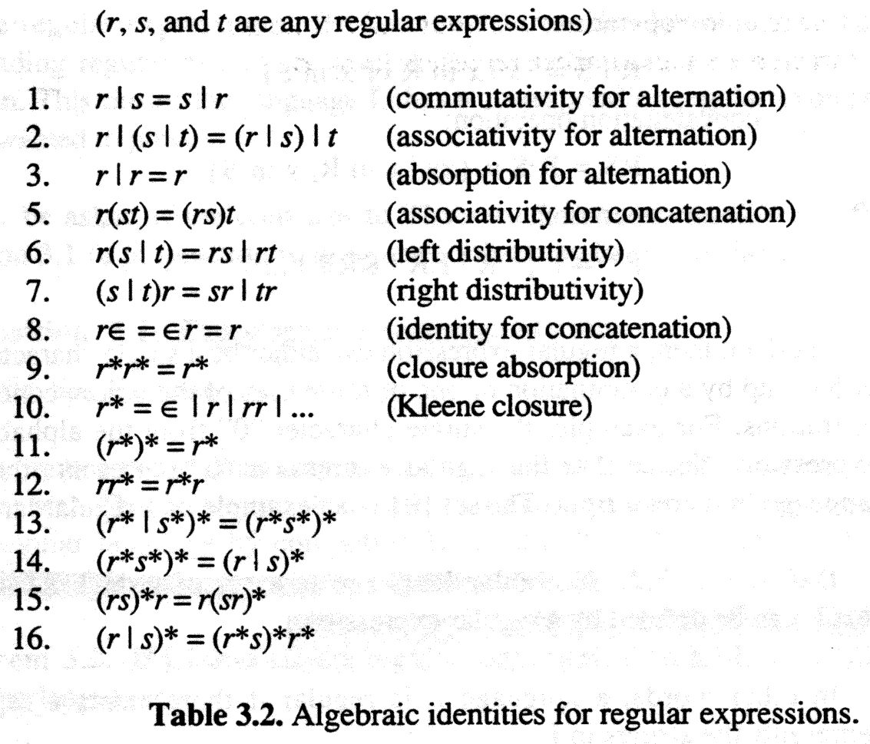
Dr Aftab Maroof - Theory of Automata

Slide 29
Languages Associated with Regular Expressions
Dr Aftab Maroof - Theory of Automata

Slide 30
Definition
The following rules define the language associated with any regular expression:
Rule 1: The language associated with the regular expression that is just a single letter is that one-letter word alone, and the language associated with Λ is just {Λ}, a one-word language.
Rule 2: If r₁ is a regular expression associated with the language L₁ and r₂ is a regular expression associated with the language L₂, then:
  (i) The regular expression (r₁)(r₂) is associated with the product L₁L₂, that is the language L₁ times the language L₂:
  language(r₁r₂) = L₁L₂
Dr Aftab Maroof - Theory of Automata

Slide 31
Definition contd.
Rule 2 (cont.):
  (ii) The regular expression r₁ + r₂ is associated with the language formed by the union of L₁ and L₂:
  language(r₁ + r₂) = L₁ + L₂
  (iii) The language associated with the regular expression (r₁)* is L₁*, the Kleene closure of the set L₁ as a set of words:
  language(r₁*) = L₁*
Dr Aftab Maroof - Theory of Automata

Slide 32
Finite Languages Are Regular
Dr Aftab Maroof - Theory of Automata

Slide 33
Theorem 5
If L is a finite language (a language with only finitely many words), then L can be defined by a regular expression. In other words, all finite languages are regular.
Proof
Let L be a finite language. To make one regular expression that defines L, we turn all the words in L into boldface type and insert plus signs between them.
For example, the regular expression that defines the language
L = {baa, abbba, bababa} is baa + abbba + bababa
This algorithm only works for finite languages because an infinite language would become a regular expression that is infinitely long, which is forbidden.
Dr Aftab Maroof - Theory of Automata

Slide 34
How Hard It Is To Understand A Regular Expression
Let us examine some regular expressions and see if we could understand something about the languages they represent.
Dr Aftab Maroof - Theory of Automata

Slide 35
Example
Consider the expression
(a + b)*(aa + bb)(a + b)* =(arbitrary)(double letter)(arbitrary)
This is the set of strings of a’s and b’s that at some point contain a double letter.
Let us ask, “What strings do not contain a double letter?” Some examples are
Λ, a, b, ab, ba, aba, bab, abab, baba, …
Dr Aftab Maroof - Theory of Automata

Slide 36
Example contd.
The expression (ab)* covers all of these except those that begin with b or end with a. Adding these choices gives us the expression:
(Λ + b)(ab)*(Λ + a)
Combining the two expressions gives us the one that defines the set of all strings
(a + b)*(aa + bb)(a + b)* + (Λ + b)(ab)*(Λ + a)
Dr Aftab Maroof - Theory of Automata

Slide 37
Examples
Note that
(a + b*)* = (a + b)*
since the internal * adds nothing to the language. However,
(aa + ab*)* ≠ (aa + ab)*
since the language on the left includes the word abbabb, whereas the language on the right does not. (The language on the right cannot contain any word with a double b.)
Dr Aftab Maroof - Theory of Automata

Slide 38
Example
Consider the regular expression: (a*b*)*.
The language defined by this expression is all strings that can be made up of factors of the form a*b*.
Since both the single letter a and the single letter b are words of the form a*b*, this language contains all strings of a’s and b’s. That is,
(a*b*)* = (a + b)*
This equation gives a big doubt on the possibility of finding a set of algebraic rules to reduce one regular expression to another equivalent one.
Dr Aftab Maroof - Theory of Automata

Slide 39
Introducing EVEN-EVEN
Consider the regular expression
E = [aa + bb + (ab + ba)(aa + bb)*(ab + ba)]*
This expression represents all the words that are made up of syllables of three types:
type₁ = aa
type₂ = bb
type₃ = (ab + ba)(aa + bb)*(ab + ba)
Every word of the language defined by E contains an even number of a’s and an even number of b’s.
All strings with an even number of a’s and an even number of b’s belong to the language defined by E.
Dr Aftab Maroof - Theory of Automata

Slide 40
Algorithms for EVEN-EVEN
We want to determine whether a long string of a’s and b’s has the property that the number of a’s is even and the number of b’s is even.
Algorithm 1: Keep two binary flags, the a-flag and the b-flag. Every time an a is read, the a-flag is reversed (0 to 1, or 1 to 0), and every time a b is read, the b-flag is reversed. We start both flags at 0 and check to be sure they are both 0 at the end.
Algorithm 2: Keep only one binary flag, called the type₃-flag. We read letter in two at a time. If they are the same, then we do not touch the type₃-flag, since we have a factor of type₁ or type₂. If, however, the two letters do not match, we reverse the type₃-flag. If the flag starts at 0 and if it is also 0 at the end, then the input string contains an even number of a’s and an even number of b’s.
Dr Aftab Maroof - Theory of Automata

Slide 41
EVEN-EVEN
If the input string is
aaabbbbaabbbbbbbababbbbaaa
Then by factoring in sub-strings of two letters each:
(aa)(ab)(bb)(ba)(ab)(bb)(bb)(bb)(ab)(ab)(bb)(ba)(aa)
0 1 1 0 1 1 1 1 0 1 1 0 0
by Algorithm 2, the type₃-flag is reversed 6 times and ends at 0.
We give this language the name EVEN-EVEN. so, EVEN-EVEN ={Λ, aa, bb, aaaa, aabb, abab, abba, baab, baba, bbaa, bbbb, aaaaaa, aaaabb, aaabab, …}
Dr Aftab Maroof - Theory of Automata

Slide 42
Ex-1
Find a regular expression for the set A of binary strings which have no substring 001.
Solution. A string x in this set has no substring 00, except that it may have a suffix 0^{K} for k > 2.
The set of strings with no substring 00 can be represented by the regular expression
(01 + 1)*(λ+0)
Therefore, set A has a regular expression
(01 + 1)*(λ + 0 + 000*) = (01 + 1)*0*
Dr Aftab Maroof - Theory of Automata

Slide 43
Ex-2
Find a regular expression for the set B of all binary strings with at most one pair of consecutive 0 's and at most one pair of consecutive 1s.
Solution. A string x in B may have one of the following forms:
(1) λ
(2) u₁0 (4) u₁0 0v₁ (6) u₁0 0w₁11v₀
(3) u₀1 (5) u₀11v₀ (7) u₀11w₀00v₁
where u₀ , u₁ , v₀ , v₁ , w₀ , w₁ are strings with no substring 00 or 11, and u₀ ends with 0, u₁ ends with 1, v₀ begins with 0, v₁ begins with 1, w₀ begins with 0 and ends with 1, and w₁ begins with 1 and ends with 0.
Now, observe that these types of strings can be represented by simple regular expressions…
Dr Aftab Maroof - Theory of Automata

